Slide 1



Reflecting on challenges and opportunities for the sector
Sam Keenan, Deputy Director-General
Te Uru Rākau – New Zealand Forest Service
8 October 2025

Slide 2
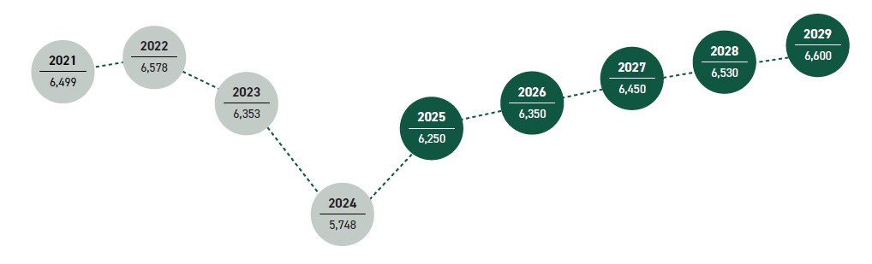

Forestry export revenue 2021-29: MPI SOPI Report

Slide 3
Top forestry export markets

Slide 4
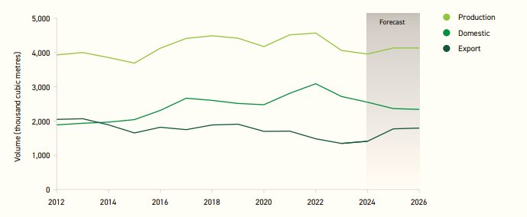
An increasing share of sawn timber production for export?

Slide 5
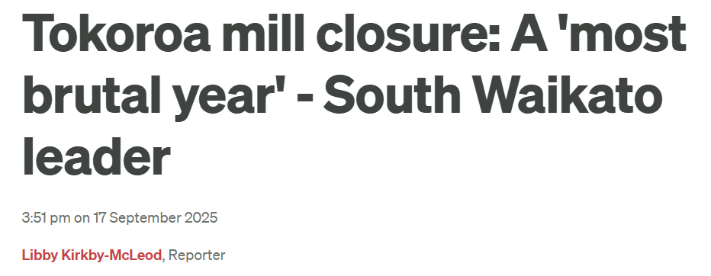
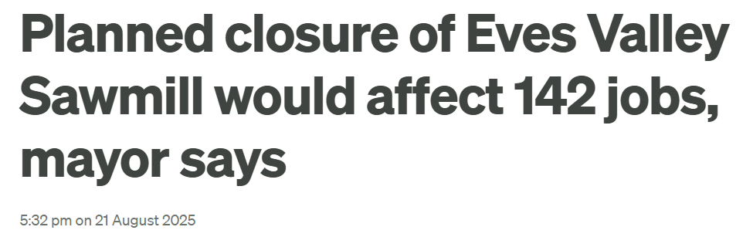
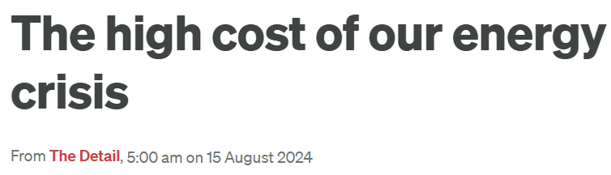
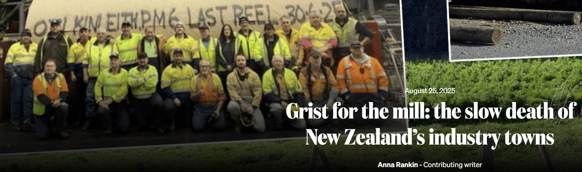
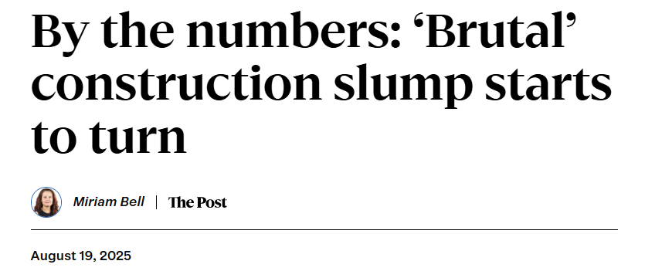
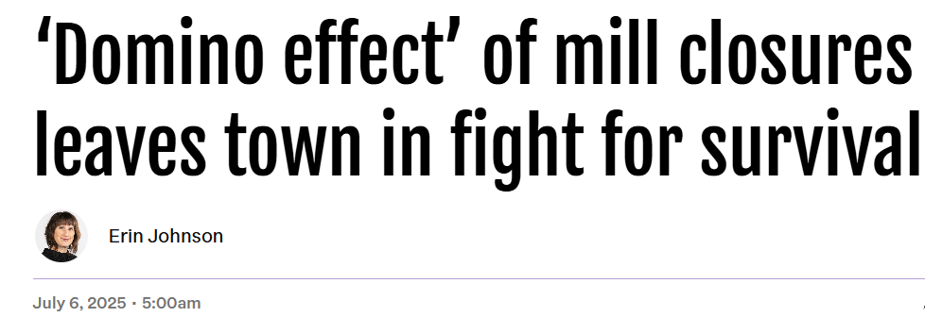
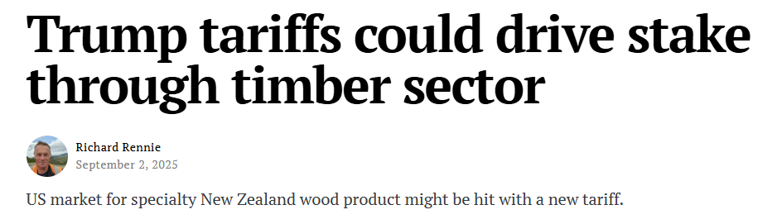
The challenges…

Slide 6
The mega trends impacting softwood markets…
Sustainability
Urbanisation and housing demand
Technological advancements
Climate and environmental regulations
Global trade dynamics

Slide 7

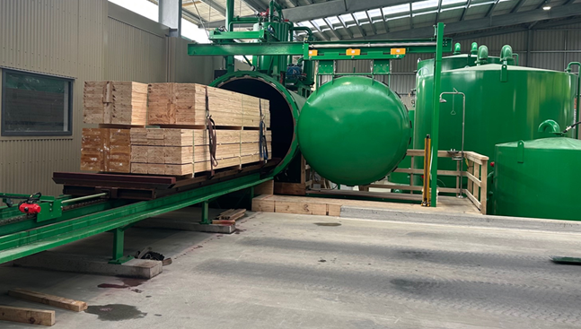
Case study: Investing for growth and resilience

Slide 8



There are a range of products that can support wood processors
Investment Boost
Primary Sector Growth Fund
Regional Infrastructure Fund
Investment Boost allows you to claim 20% of the cost of new assets as an expense, then depreciation as usual on the remaining 80%
The reconfigured PSGF can support investments in biomaterials and other innovative projects using forestry feedstocks
The RIF is looking to support investments in energy security

Slide 9


Slide 10

Thank you.

