Slide 1

Outlook for business & the economy
Wood Processors & Manufacturers Association
Katherine Rich
Chief Executive BusinessNZ

Slide 2


Slide 3
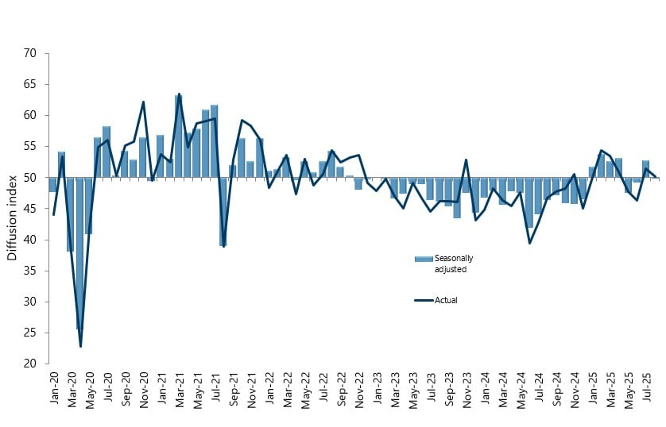
Manufacturing sector

Slide 4
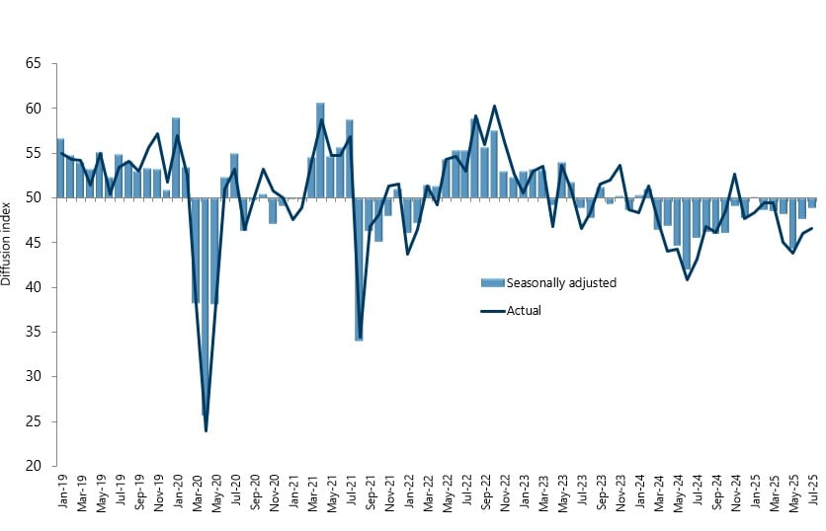
Services sector

Slide 6


Slide 7
