Slide 1
Chain of Custody and Australia’s Illegal Logging Laws
WPMA Conference
October 2025

Slide 2
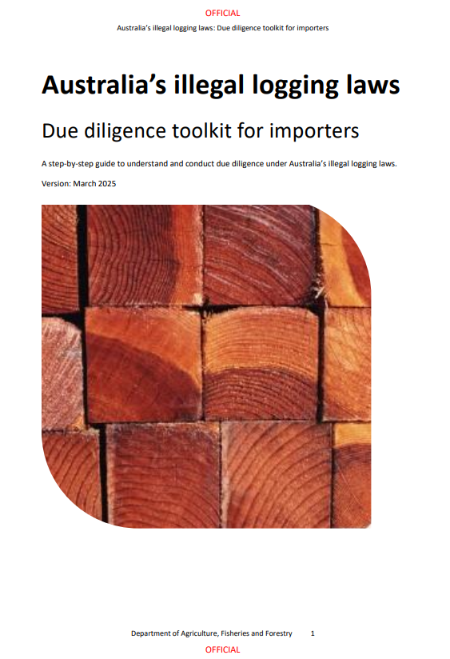
Obligations of the Illegal Logging Laws
Note: They apply equally to domestic processors and importers.

Slide 3
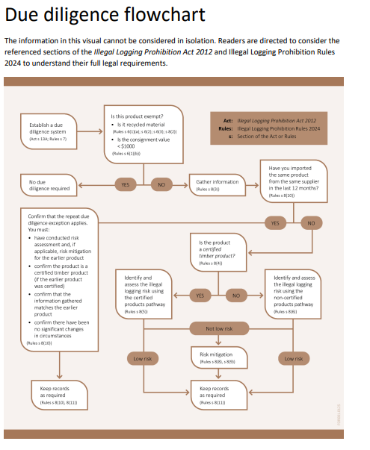

Slide 4
Two Due Diligence PATHWAYS
The certified pathway
The non-certified pathway

Slide 5
Risk Assessment- Certified Pathway
Obtain delivery information including the certification claim from the supplier.
Go to the Responsible Wood or PEFC databases and check
a. The supplier has a valid certification
b. The materials supplied and within the scope of certification.
Keep a clear written record that a decision was made that materials are low risk.
Regularly recheck the databases and keep a record.

Slide 6
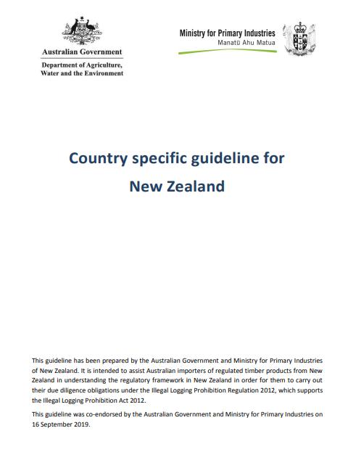
Risk assessment- Not certified- Country Specific Guidelines
Do you know the exporter?
Did the wood originate in NZ/ Is it a NZ species?
Traceability- log delivery dockets for processed wood plus port delivery dockets?
Harvested Wood levy Statement (do you still have this?)
Make sure that you keep records of the decision and evidence it is based on.

Slide 7
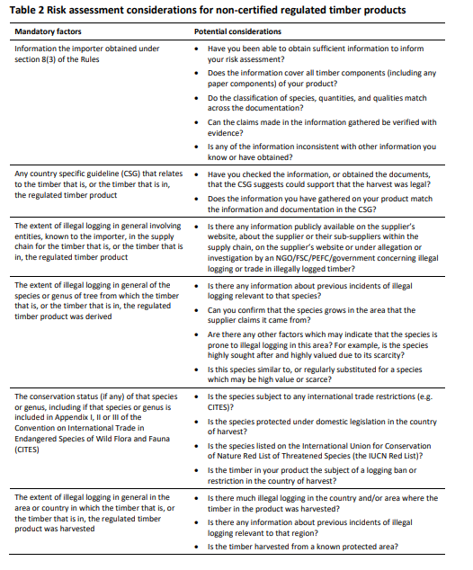
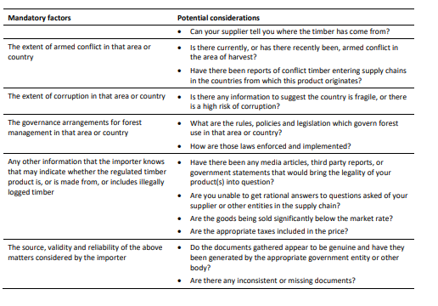
Risk assessment- Not certified- NO Country Specific Guidelines

Slide 8
Challenges
Laundering of Conflict Timber in certified supply chains.
Possible strengthening of due diligence?

Slide 9
Thank you for your attention.

