Slide 1


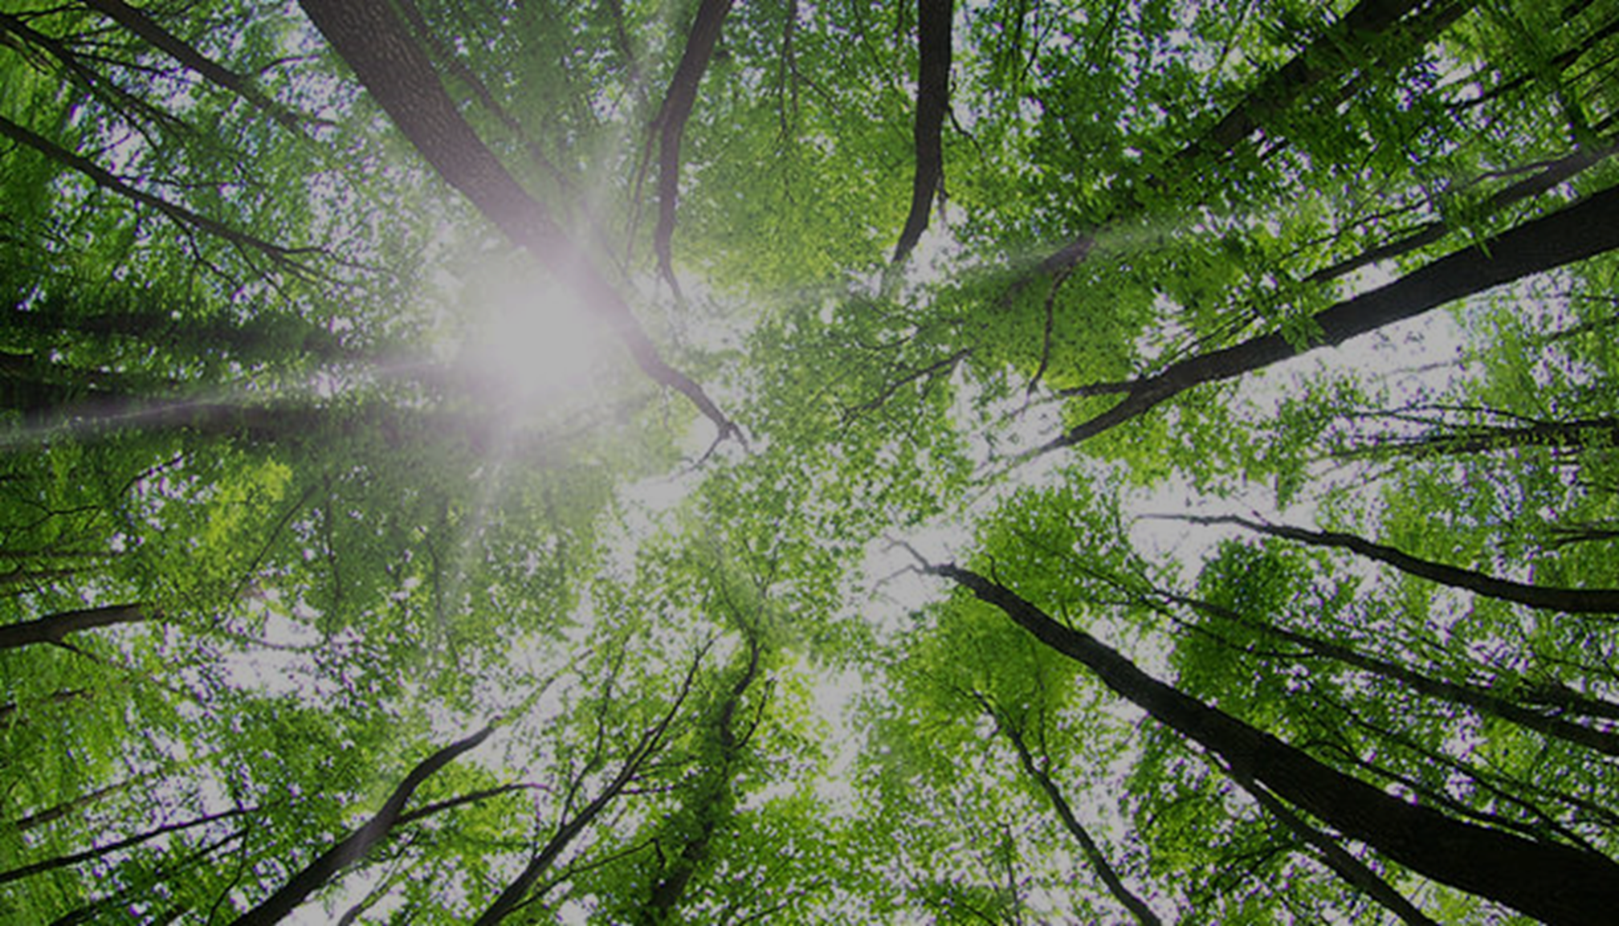
NZ Bio Forestry™
A Future Renewable
Wood Processors & Manufacturers Association – NZ
Te Papa - Wellington
Building a World-Leading Bio-Economy From Aotearoa-NZ Forests.
Petroleum & Fossil Free
Everything Made
Nature Friendly
Everything Done
No Waste
Everything Used
REDUCE GHG LIABILITY
DECARBONISATION
MONETISE WHOLE
Wayne Mulligan
CEO, Founder: NZ Bio Forestry
www.nzbioforestry.co.nz

Slide 2

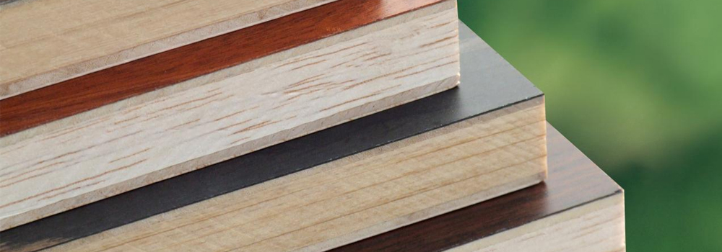
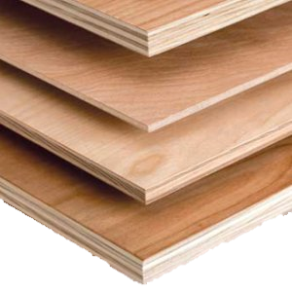
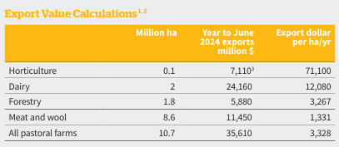
NZ Bio Forestry™
A Future Renewable
Carbon Sequestration & Sustainably Managed: Value
Timber Low Emission: Value
Healthier Environment: Value
Many Products: Value
Carbon Stored : Value
Feedstock for Bio-Based Product: Value
Wood Processing and Manufacturing is Critical

Slide 3
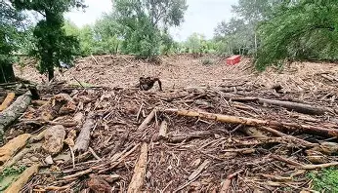
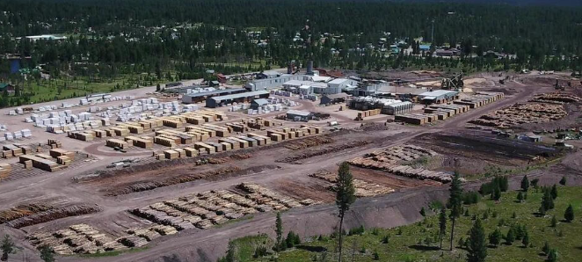
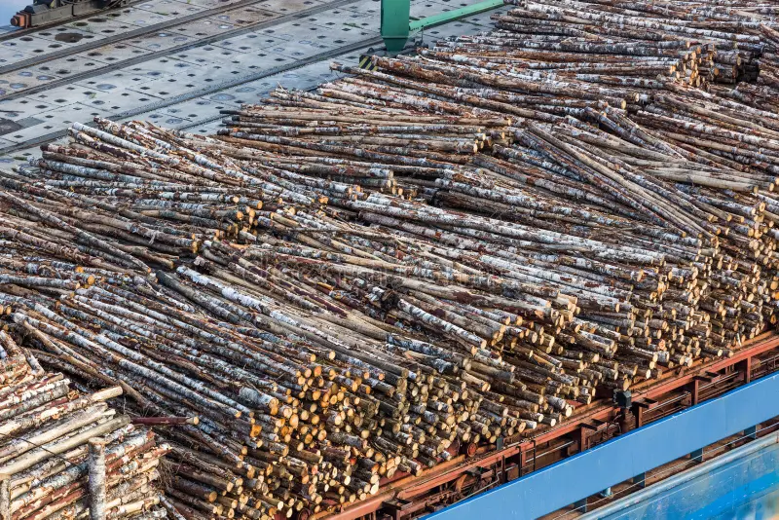
NZ Bio Forestry™
A Future Renewable
DAMAGE, DESTRUCTION, HEALTH & SAFETY
When the public think of NZ wood and forestry industries – what resonates and repeats?
ONGOING MILL CLOSURES; JOB LOSSES; RURAL ECONOMIC STRESS
MILLION M3 (TONNE) RAW LOGS SHIPPED - NO VALUE ADD

Slide 4
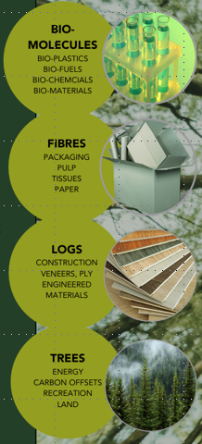
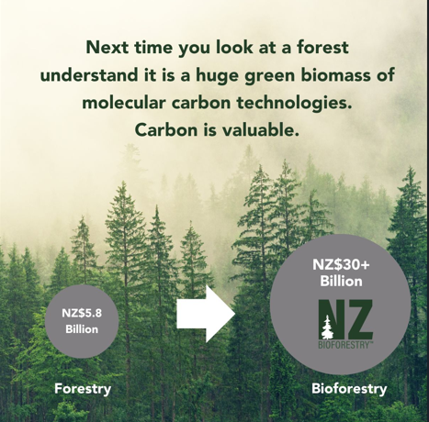
NZ Bio Forestry™
A Future Renewable
Right Mauri.
Never Let a Good Crisis Go By (BUY)
If you want to change the value of the sector: Change Markets.
Innovation rarely occurs in the mainstream: Occurs first in their Blind-Spot.

Slide 5
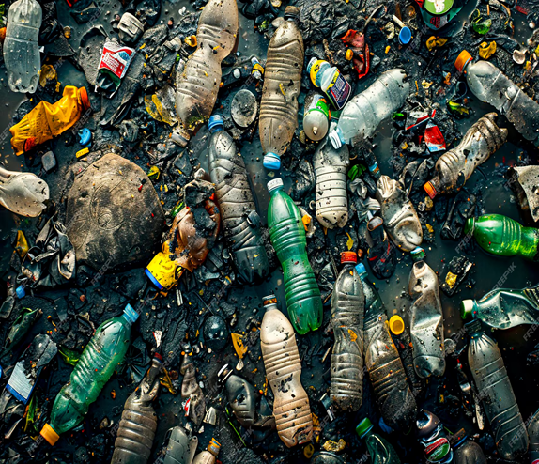
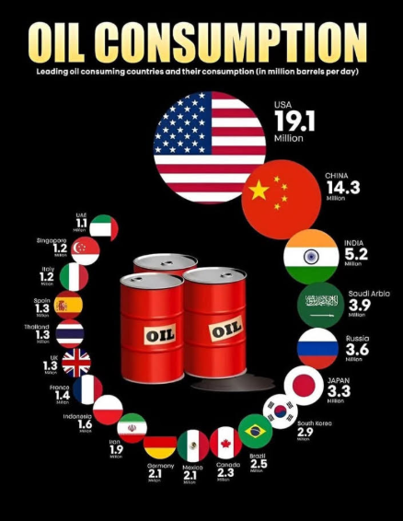
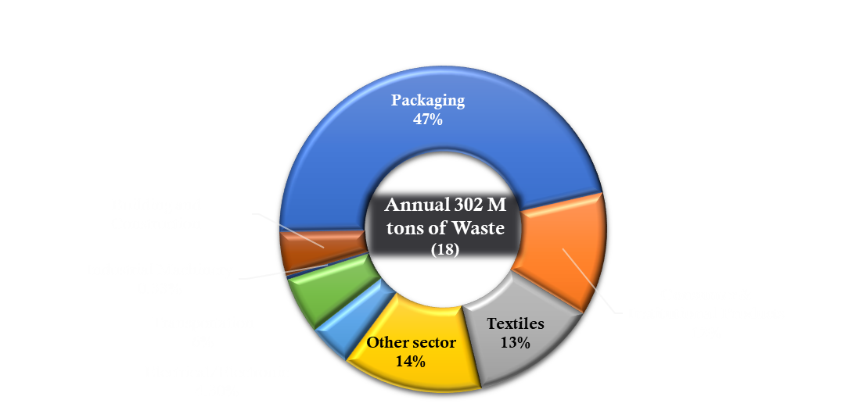
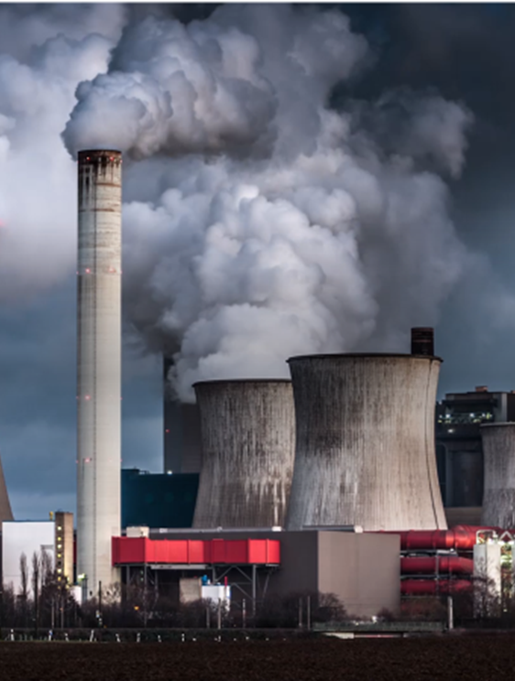
NZ Bio Forestry™
A Future Renewable
Right Kaupapa.
NZ Asia-Pacific group.
Convert wood biomass - bioenergy, biochemicals and biomaterials.
18. Roland Geyer et al. Sci Adv 2017;3:e1700782

Slide 6
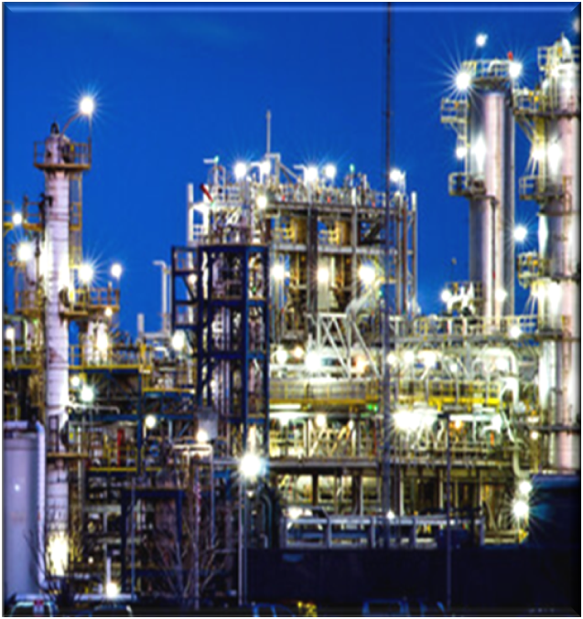
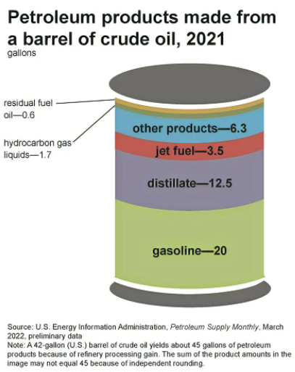
NZ Bio Forestry™
A Future Renewable
Right Strategy.
Chemical sector. Renewable forestry.
Sophistication equal petrochemical.
Products | %
Gasoline | 45%
Ultra-low sulfur diesel | 25%
Kerosene & jet fuel | 9%
Residual fuel | 2%
Other products | 13%
Distillate / heating oil | 2%
Hydrocarbon gas liquids | 4%
Bio CHEMICALS
Bio MATERIALS
Bio
ENERGY
Detergents, paint & solvents, propane, plastic products, and synthetic rubber
Every Economy Requires

Slide 7
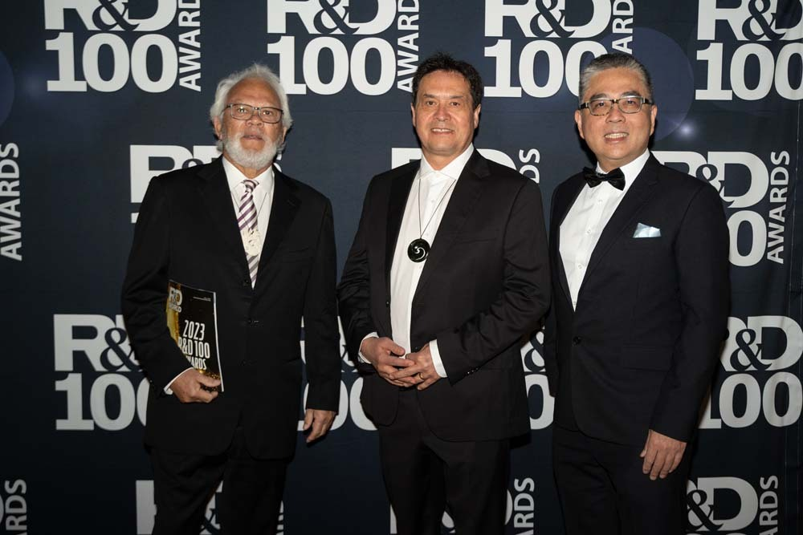

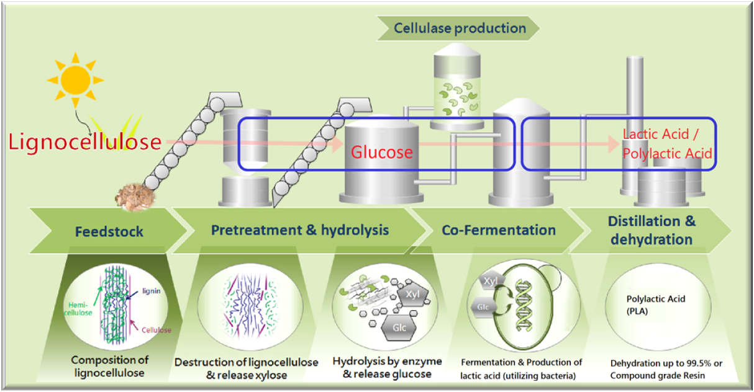
NZ Bio Forestry™
A Future Renewable
Right Technologies.
2023 Top 100 Global R&D Award
Fixed Carbon Technology: Carbon-Negative Bioplastics.
One of the 100 Most Technologically Significant New Products of the Year in Process/Prototyping

Slide 8
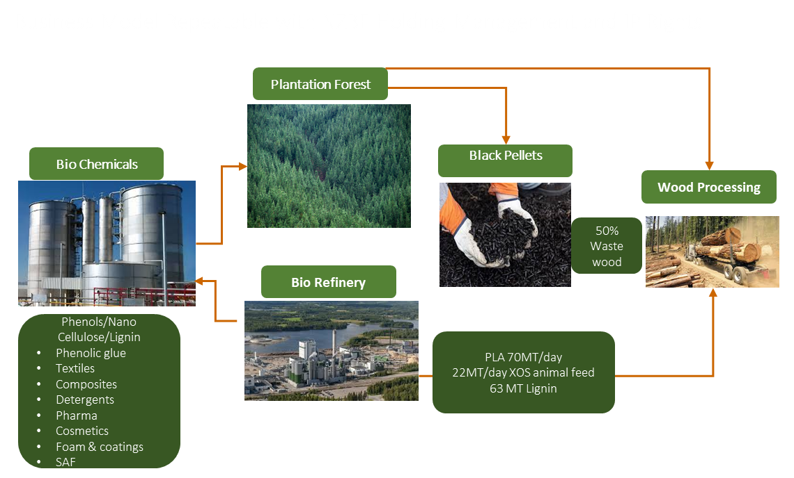
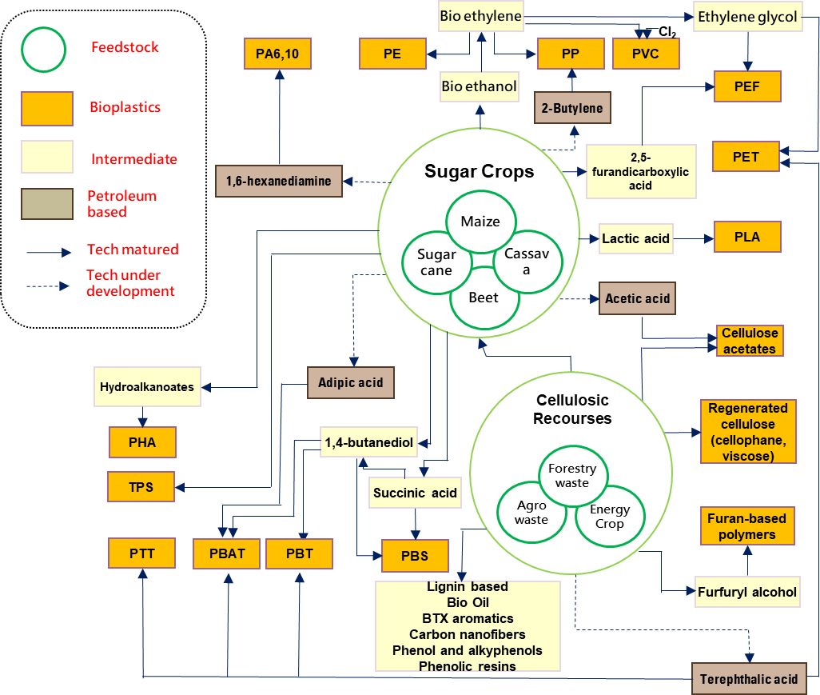
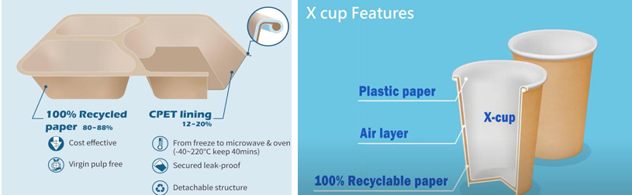
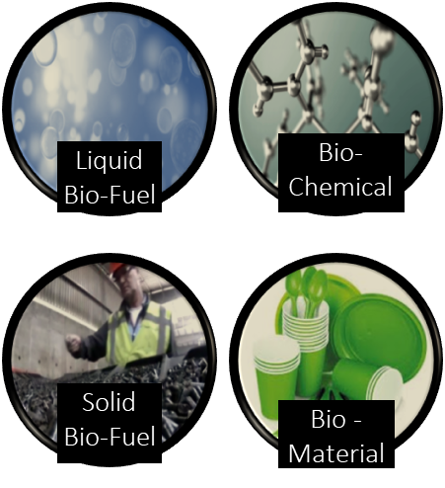
NZ Bio Forestry™
A Future Renewable
Right Bio-Solutions.
4 billion Units
$3-4k ton
12 billion units
Circulate Water, Single Logistic Hub
Circulate Steam and Energy

Slide 9
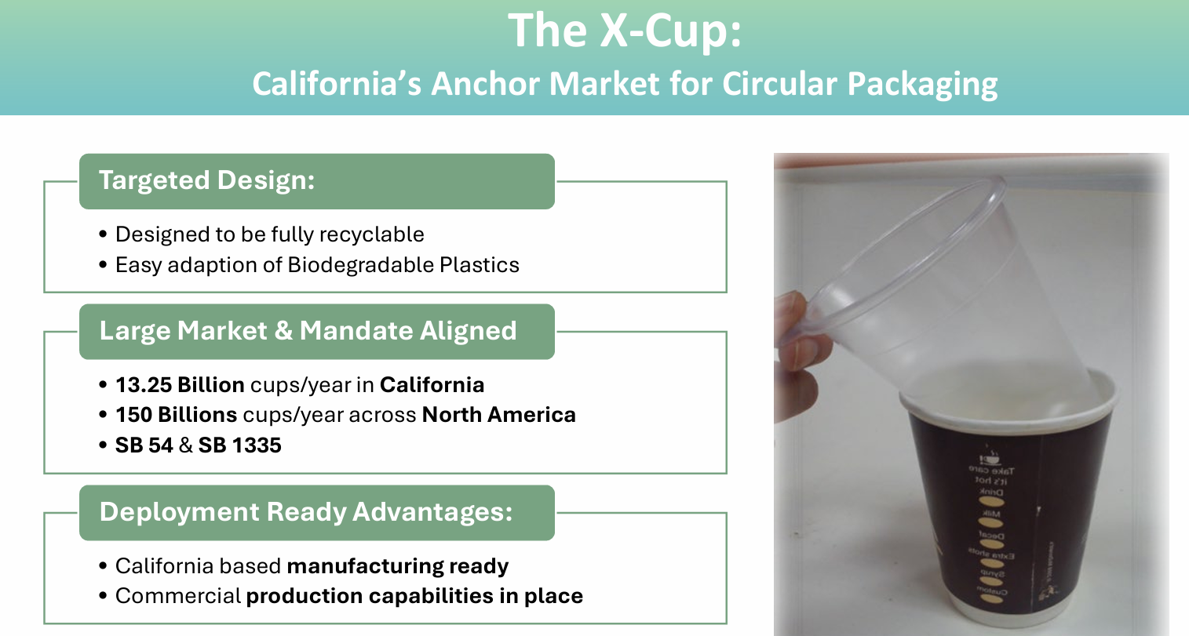
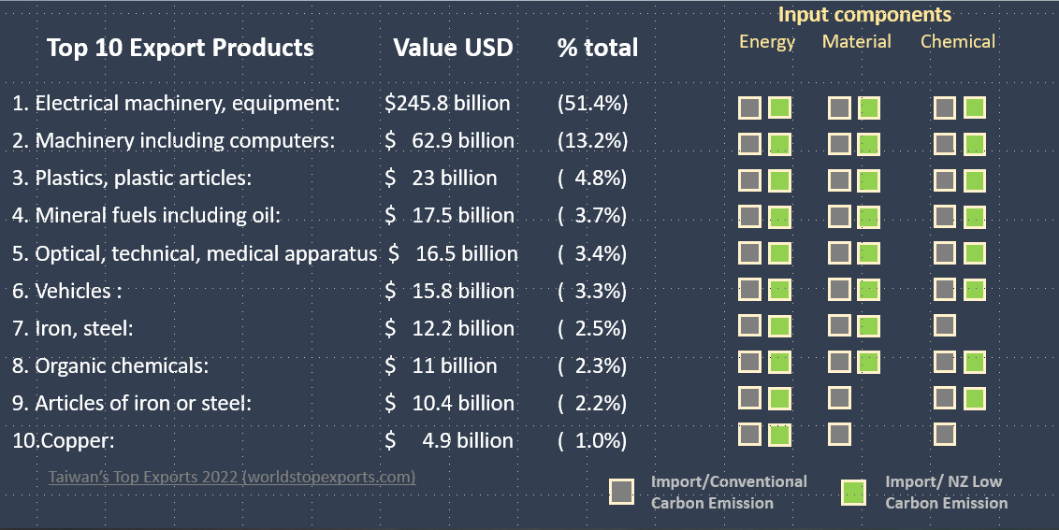



NZ Bio Forestry™
A Future Renewable
Right Market Incentives.
Taiwan
Border Carbon Adjustments (BCAs)
Carbon Border Adjustment Mechanism (CBAM)
New Carbon Border Tax proposal

Slide 10
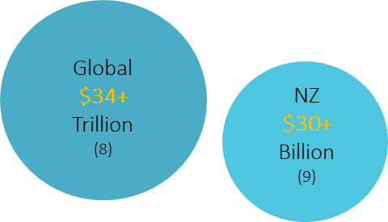
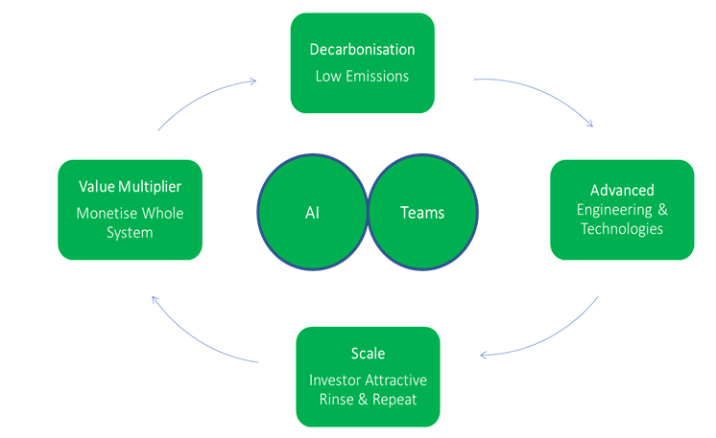
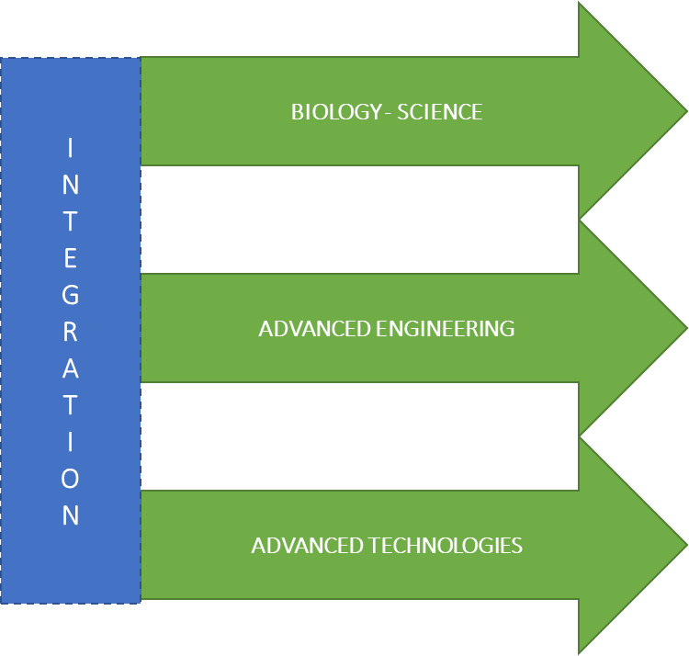
NZ Bio Forestry™
A Future Renewable
Right Competitiveness.
Sustainability = Fiscal
Monetise = Whole Method/Tree
Productivity = Digital Platform
Scale = Repeatable
8. Global Green Investment: $35 Trillion in Sustainability Funds. Does it Do Any Good? – Bloomberg New McKinsey Report Sees A $4 Trillion Gold Rush In This One Hot Sector. Who’s Selling Picks And Shovels? (forbes.com)
9. Bio-Plastics – Bio Polymers Bioplastics Market is Potential Value of Bio-Products from Forests

Slide 11
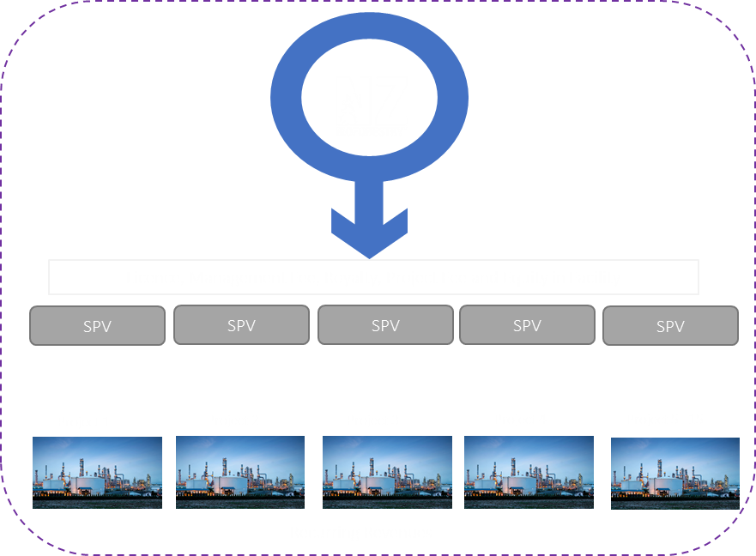
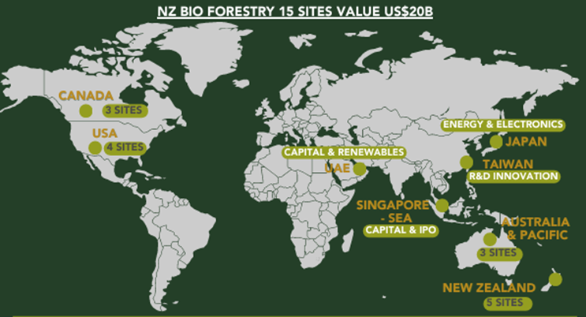
NZ Bio Forestry™
A Future Renewable
Right Global Scale.

Slide 12

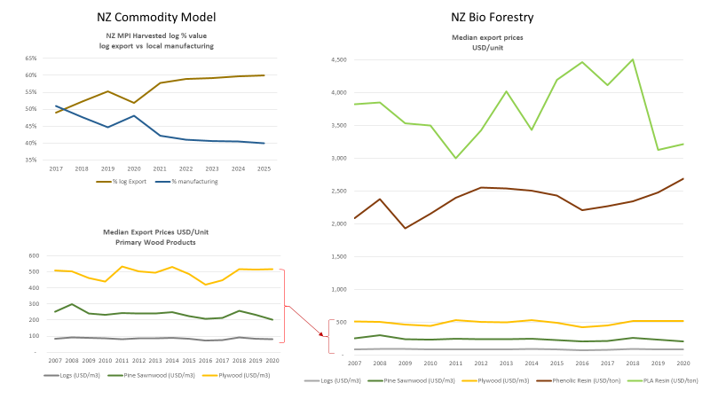


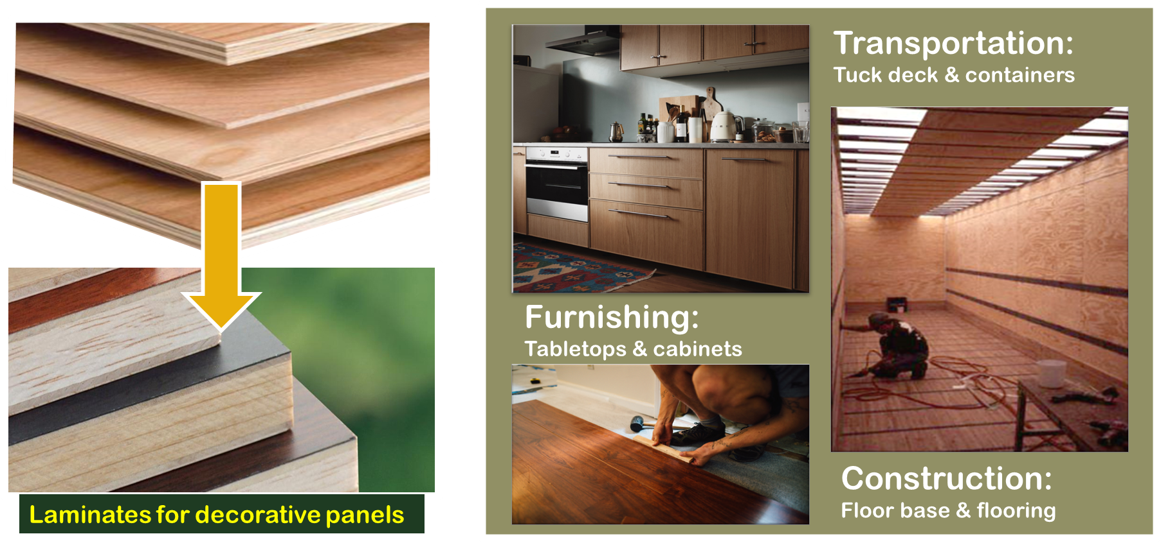
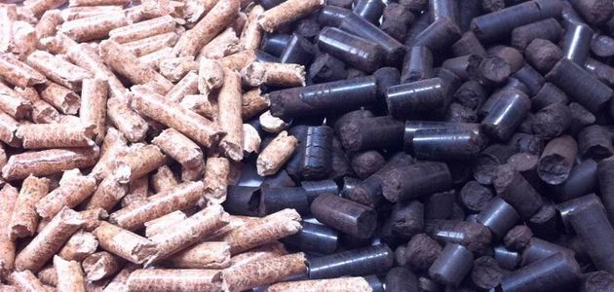
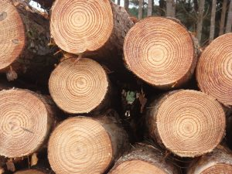
NZ Bio Forestry™
A Future Renewable
Right Productivity & GDP.
EPOXY, BIO-ADHESIVES, SOLVENTS
US$4000 -$5000+
X46- X77
PLA - PHA
US$3000 -$4000
X46- X61
DECORATIVE PLY
US$650 -$1000
X10 – X15.4
ENERGY GENERATION
US$230 -$350
X3.5 – X5.4
LOG
NZ$130
(NZ$90-$160)
(US$50 – US$110 ton/m3)

Slide 13

NZ Bio Forestry™
A Future Renewable
Right Time.
Petroleum & Fossil Free
Everything Made
REDUCE GHG LIABILITY
Nature Friendly
Everything Done
DECARBONISATION
No Waste
Everything Used
MONETISE WHOLE

Slide 14

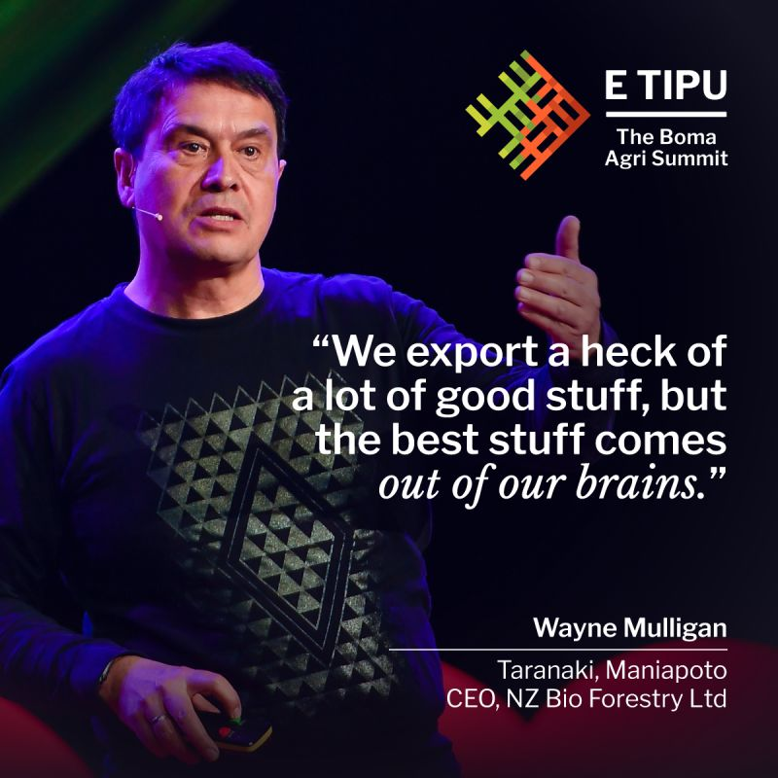

NZ Bio Forestry™
A Future Renewable
Ngaa Mihi
Warm Thank You.
Wayne Mulligan
CEO, Founder: NZ Bio Forestry
www.nzbioforestry.co.nz

