Slide 1


Seeing the Wood for the trees – the role of forestry in doubling the value of New Zealand Export earnings
Dr Elizabeth Heeg, CEO

Slide 2
Opportunities for Forestry
Increased demand for sustainable building materials
Export growth in paper, sawn timber, and other forestry products

Slide 3
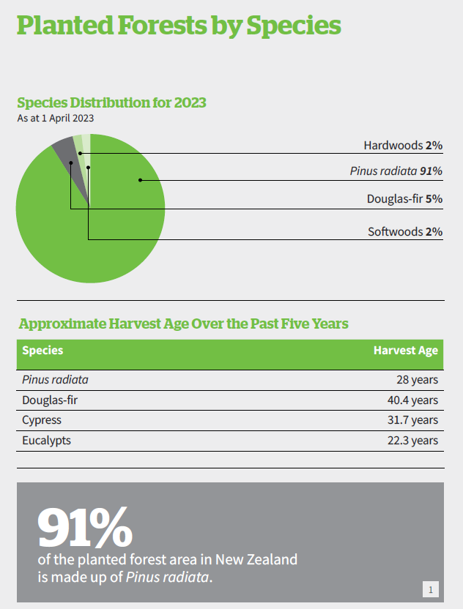

Slide 4
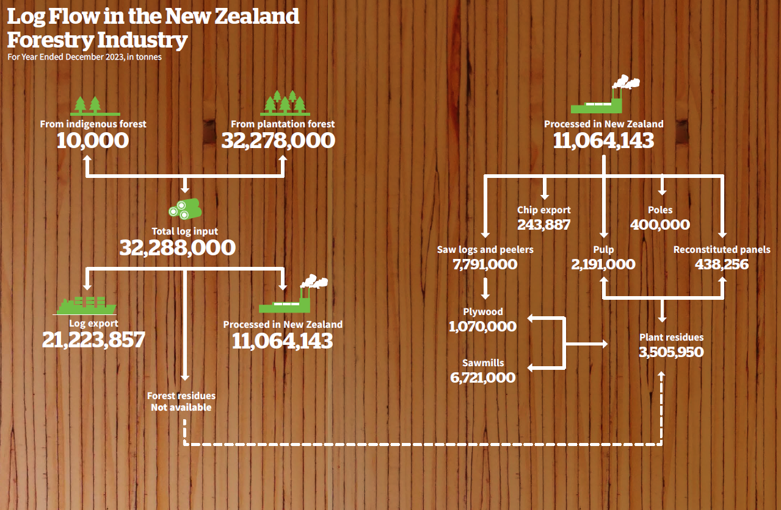

Slide 5
New Zealand Cannot double export value with logs. we don’t have the logs available nor do we have the demand or ability. And we cannot dictate the log price.

Slide 6
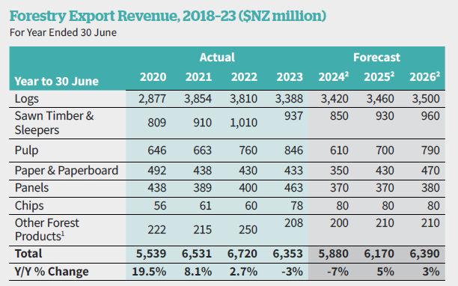
Value will come from onshore processing or at least partial processing.

Slide 7
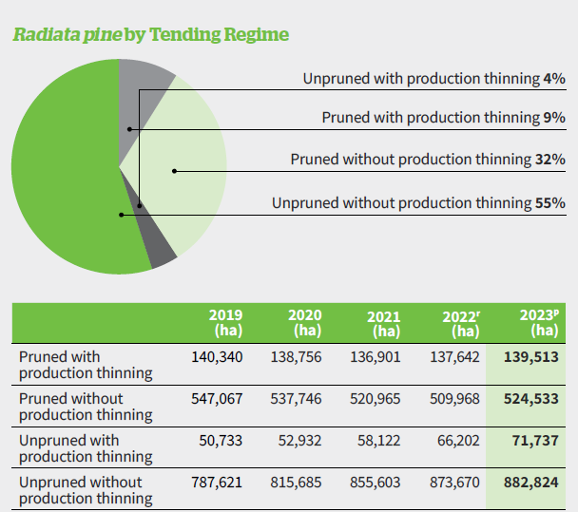
Adding the value for domestic processing supported by timber management regime

Slide 8
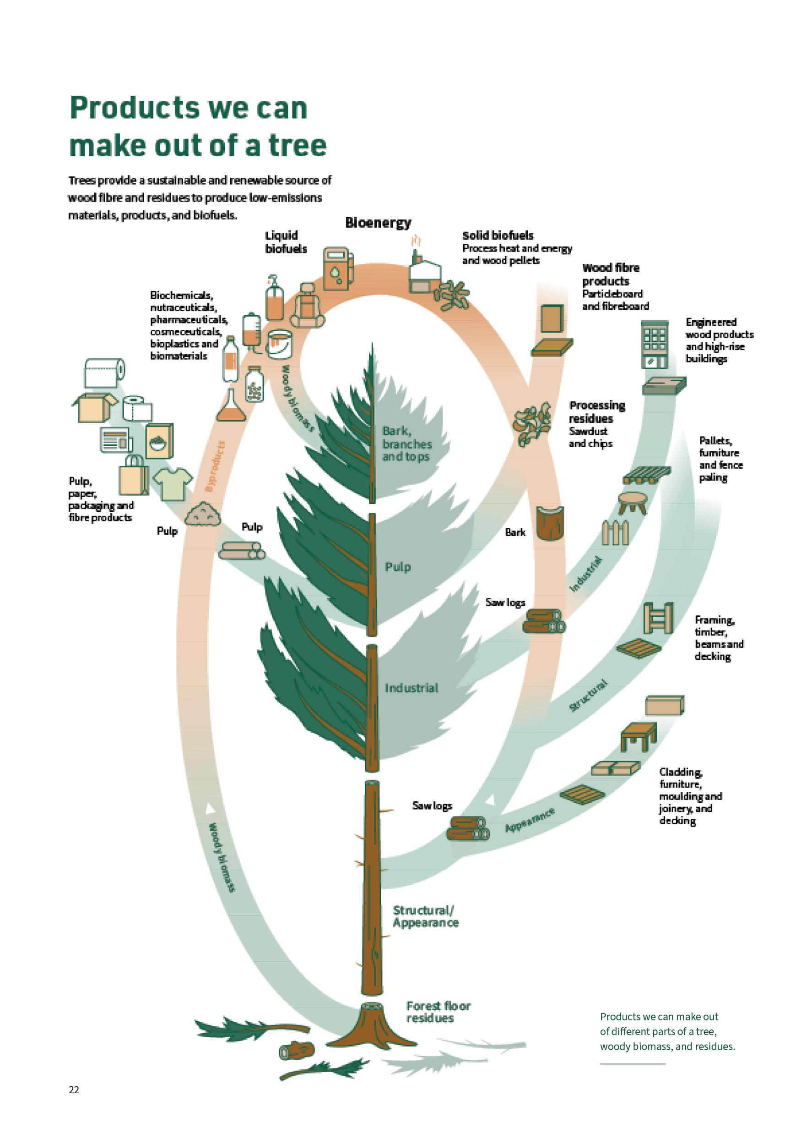
Onshore processing gives us arisings with which we can create entire new value streams

Slide 9
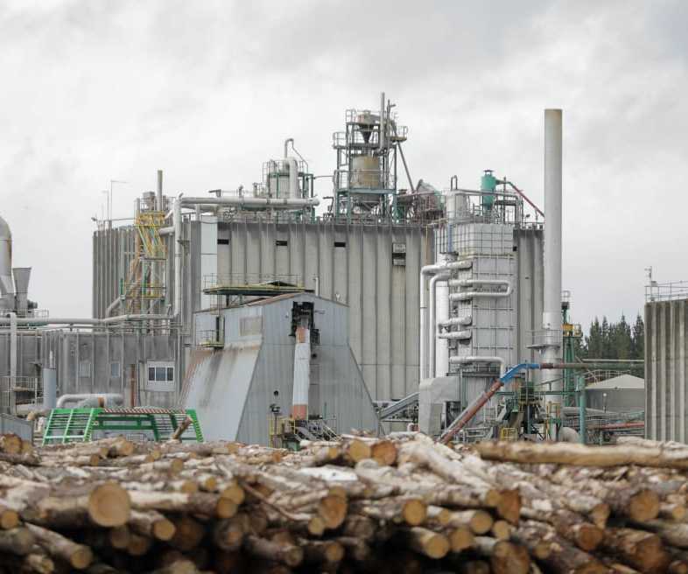
Onshore processing faces many obstacles
These include:
consents,
energy issues,
labour,
training and
infrastructure.
RNZ

Slide 10
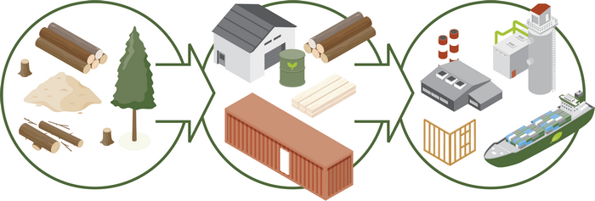
Opportunities around manufacturing and energy hubs – identify where resource, labour transport, ports and infrastructure are
Scion

Slide 11
Opportunities
Growth in India, Vietnam and Southeast Asia
Mass timber construction
Bioeconomy – new products
Pruned clearwood
Innovation in value-added exports
Notes:
NZ has a competitive advantage with growing pruned clearwood. Good niche product. Higher end product.

Slide 12
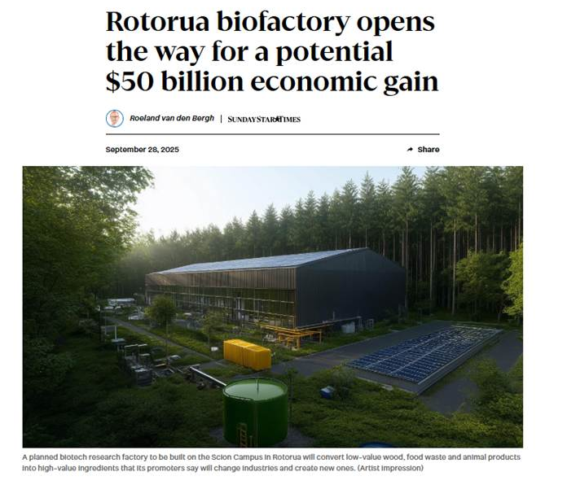
Notes:
Potential $19 billion opportunity according to 2023 Product Accelerator Report in forest bioproducts for New Zealand

Slide 13
Export markets for different products
MPI SOPI Year to March 31 2025, NZ$ million and percent

Slide 14
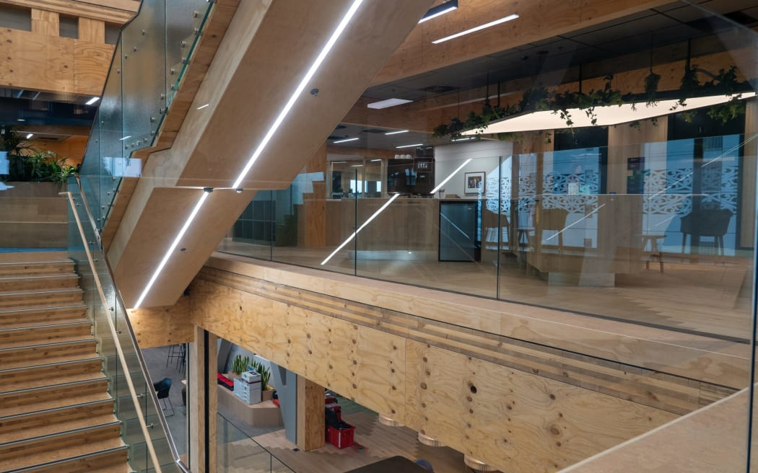
Notes:
RNZ – Tauranga 90 Devonport Rd

Slide 15
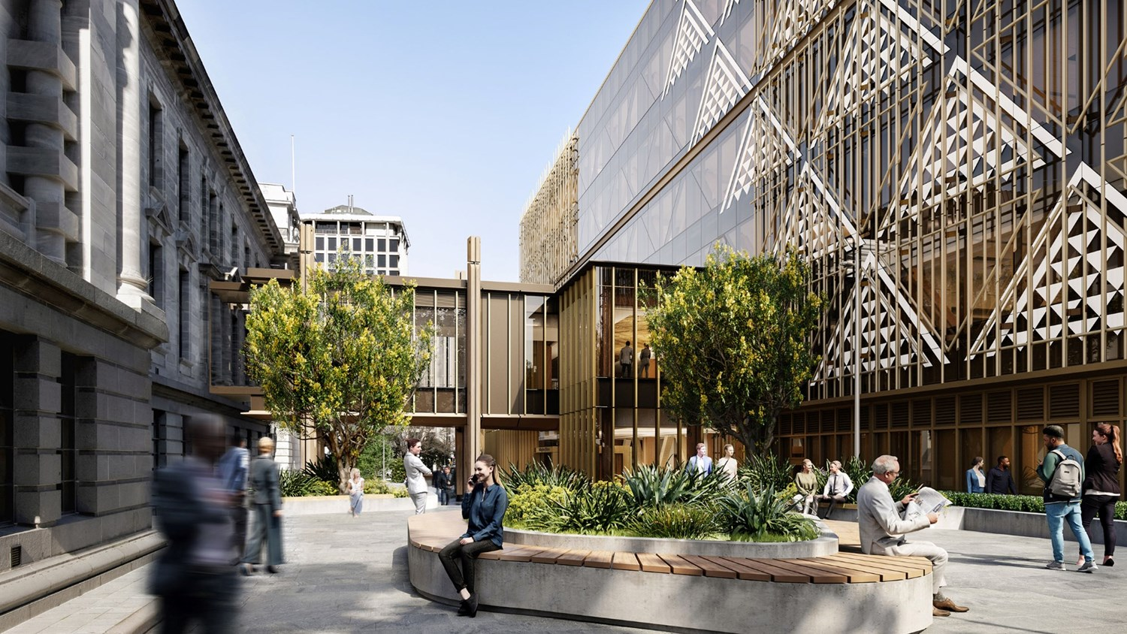

Slide 16
What we need to achieve success
Controllable by industry:
Building relationships and reputation in market
People and financial resources to grow markets
Technology adoption and innovation
Research commercialization
Controllable by government:
New Zealand reputation
Energy pricing
Consenting processes/regulatory environment
Labour shortages
Government funded research commercialization
But collaboration has to underpin all of this

Slide 17

Questions?

